Slide 1


Data migration from on premise database to SQL managed instance on Azure cloud using Azure Data factory – A working approach
https://turcomat.org/index.php/turkbilmat/article/view/8093
Author: Chandrika Bhargavi Achanta

Slide 2

What the paper accomplished
The paper efficiently tackles the challenges of moving data from on-premise databases to the cloud, emphasizing Azure Data Factory's crucial function as the main cloud-based ETL tool. It assesses the execution of data transfer procedures through a thorough case study, highlighting the critical elements of design, encryption, and testing techniques. The article offers experts working on Azure-based data engineering projects insightful information and useful tips to guarantee a safe and effective migration of databases and apps to the cloud.
Problem statement
Organizations face significant challenges when migrating their applications from on-premise databases to cloud environments, particularly concerning schema, code, and data migration. This paper aims to address these challenges by presenting a comprehensive case study utilizing Azure Data Factory as a cloud-based ETL tool. The focus is on evaluating the implementation of data migration processes, emphasizing the need for robust architecture, encryption methods, and thorough testing strategies. The goal is to provide insights and guidelines for developers, solutions architects, and project managers navigating the complexities of data migration to ensure a successful and secure transition to the cloud.

Slide 3
How paper aligns with what you have learned in this course
The paper is closely aligned with the domain of Azure Data Engineering, as it explores the practical application of Azure Data Factory, a key component of Microsoft's Azure Data Services, for addressing the challenges inherent in migrating data from on-premise databases to cloud storage or databases. It highlights the tool's capabilities in simplifying the data migration process. The content directly relates to Azure Data Engineering by offering practical guidance and a case study, making it a relevant resource for professionals and stakeholders engaged in Azure-based data engineering projects, particularly those involving the seamless transition of applications and databases to the cloud.

Slide 4
Running its $15 billion business on Azure using a hybrid cloud model, Smithfield Foods slashed datacenter costs by 60 percent, accelerated application delivery from two months to one day, and greatly improved network security.
“Azure is a great hybrid enabler.”
Chevron takes a hybrid migration approach to move many applications to Azure while continuing to take advantage of existing infrastructure and technology.
“Microsoft understands enterprises better than anyone, and they’ve been true partners with us on this journey”
Adopting a hybrid cloud infrastructure enabled by Azure allows J.B. Hunt to move workloads to the cloud that make sense and continue to run business on-premises.
“Microsoft didn’t ask us to bend to their vision of a cloud. It was Microsoft meeting us where we are today.”
Role of Data Migration in Major Organizations
More than 95 percent of Fortune 500 companies trust their business on Azure migration services today.

Slide 5



Data Factory
Activity
Azure Pipeline activities are the tasks and processes in Azure Pipelines for continuous integration and delivery. They include building, testing, packaging, and deploying applications, organized into customizable workflows, facilitating automation throughout the software development lifecycle.
Azure Data Factory is a cloud-based data integration service by Microsoft Azure, facilitating the efficient extraction, transformation, and loading (ETL) of data between various sources and destinations. It simplifies the creation and management of data pipelines for streamlined analytics and reporting, offering scalability and automation in the cloud.
Pipeline
Azure Pipelines is a cloud-based CI/CD service from Microsoft Azure, streamlining automated building, testing, and deployment of applications across various platforms. It supports diverse languages, integrates with popular development tools, and facilitates seamless deployment to Azure or other environments, enhancing the efficiency of software development processes.

Slide 6
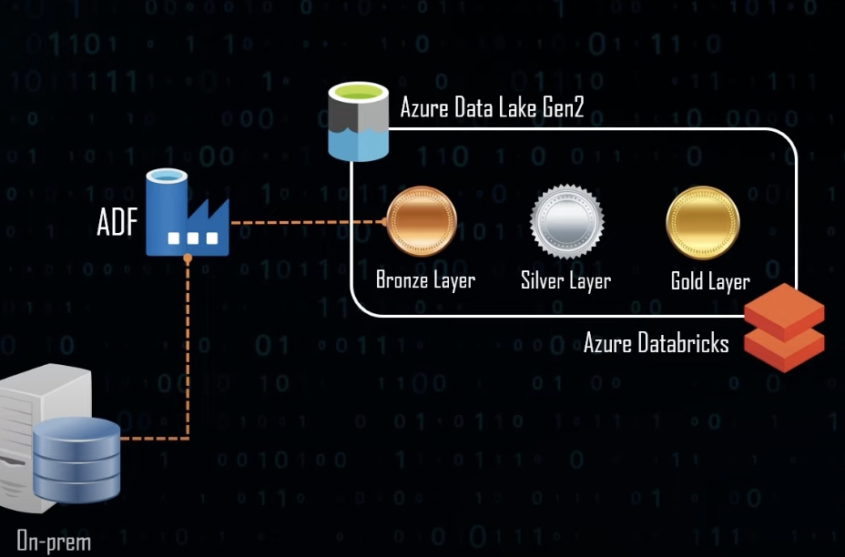
Architecture:
Conventional Approach:
Pipeline->copy activity (just one table)->SQL server DB
Advanced Approach:
Pipeline->lookup(fetch all table), foreach->copy activity->SQLserverDB

Slide 7
The study highlights how cloud computing, especially in the field of data engineering, has a revolutionary effect on data aggregation and learning. The study highlights Azure Data Factory as a key cloud-based ETL solution and demonstrates how cloud computing enables smooth data migration, resulting in effective data aggregation from various sources. This change improves data workflow automation and scalability while providing a platform for ongoing education via the provided case study.
The research demonstrates an evolutionary shift in data engineering approaches toward more agile and scalable solutions by utilizing cloud services. In addition to simplifying data migration, using Azure Data Factory offers a dynamic environment for continuous learning and development, mirroring the changing nature of data management in the cloud era.
Conclusion on
Cloud computing and
Data Engineering:

Slide 8
https://docs.microsoft.com/en-us/azure/data-factory: "Microsoft Official Website”
2. Erik Kajati, Martin Miskuf, Peter Papcun: "Advanced Analysis of Manufacturing Data in Excel and its Add-Ins" SAMI 2017 • IEEE 15th International Symposium on Applied Machine Intelligence and Informatics January 26-28, 2017 Herl'any, Slovakia
3. Pooyan Jamshidi, Aakash Ahmad, and Claus Pahl: "Cloud Migration Research: A Systematic Review" IEEE TRANSACTIONS ON CLOUD COMPUTING, VOL. 1, NO. 2, JULY-DECEMBER 2013
4. Sudhir Rawat Abhishek Narain: "Understanding Azure Data Factory Operationalizing Big Data and Advanced Analytics Solutions" Apress
5. Claus Pahl, Huanhuan Xiong, and Ray Walshe: "A Comparison of On-Premise to Cloud Migration Approaches" IC4, Dublin City University Dublin 9, Ireland
6. Qin, Hanlin Jin, Xianzhen; Zhang, Xianrong: "Research on Extract, Transform and Load(ETL) in Land and Resources Star Schema Data Warehouse" 2012 Fifth International Symposium on Computational Intelligence and Design
7. Manel Souibguia, Faten Atiguib, Saloua Zarnmalia, Samira Cherfi, Sadok Ben Yahiaa: "Data quality in ETL process: A preliminary study" 23rd International Conference on Knowledge-Based and Intelligent Information & Engineering Systems
8. Earl T. Barr, Mark Harman, Phil McMinn, Muzarnmil Shahbaz, and Shin Yoo: "The Oracle Problem in Software Testing: A Survey" IEEE TRANSACTIONS ON SOFTWARE ENGINEERING, VOL. 41, NO. 5, MAY 2015
9. https://docs.microsoft.com/en-us/azure/azure-sql/managed-instance/sql-managed-instance-paas-overview: "Microsoft Official Website"
10. Lijun Ma: "The integrity rules and constraints of the database" Proceedings of 2011 International Conference on Electronic & Mechanical Engineering and Information Technology.
11. https://azure.microsoft.com/en-us/blog/microsoft-azure-the-only-consistent-comprehensive-hybrid-cloud/
References

Slide 9
Any Questions ?
Thank you

